Slide 1
Climate Change & Greenhouse Gases 101 What’s going on, how did we get here, and what now?
Stephanie Arnold, University of Prince Edward Island
Presented in Charlottetown, PE
January 11, 2018

Slide 2
Overview
What’s going on? How did we get here?
Basics of climate change
Climate change impacts
What now?
Responding to climate change
Trivia

Slide 3
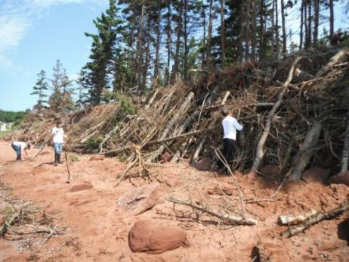
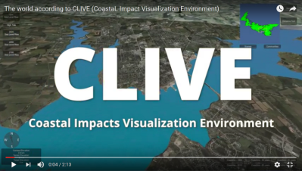
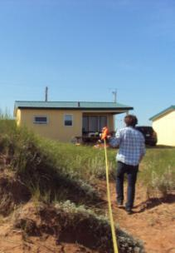
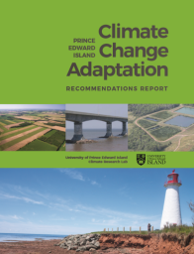
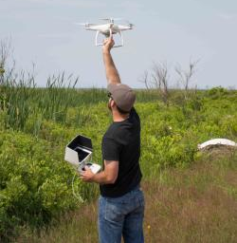
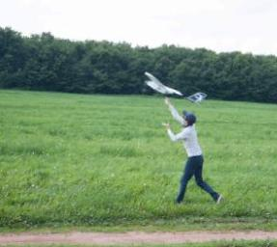
UPEI Climate Lab

Slide 4
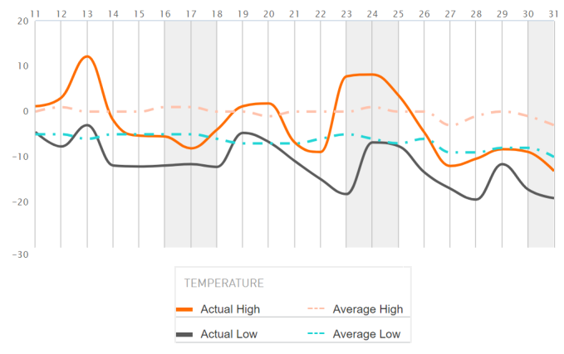
Climate change? But it’s so cold!
December 2017 - Charlottetown

Slide 5
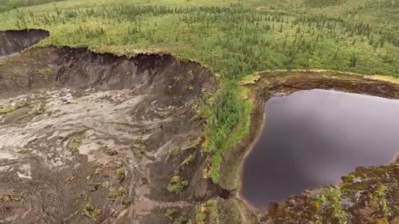
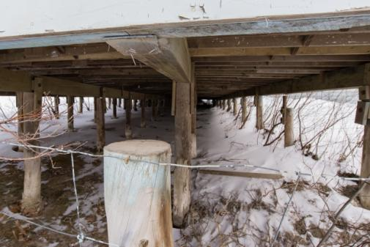
Climate change? But it’s so cold!

Slide 6
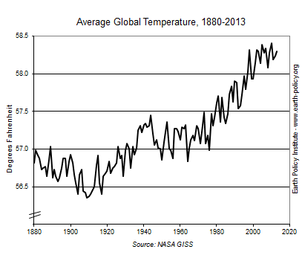
Is the climate changing?
14.8°C
14.5°C
14.2°C
13.9°C
13.6°C

Slide 7
Is the climate changing?

Slide 8
Is the climate changing?
12%
Over previous 32 years
raining/snowing less often
(# of days decreasing)
especially in summer

Slide 9
Is the climate changing?
12%
6%

Slide 10
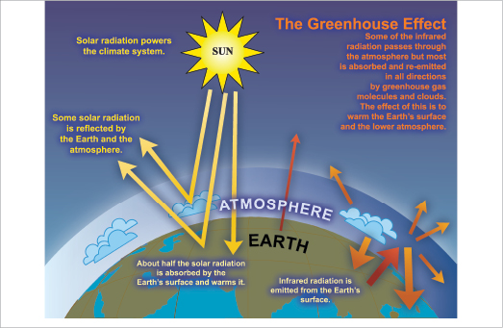
What’s causing these changes?

Slide 11
What are greenhouse gases?

Slide 12
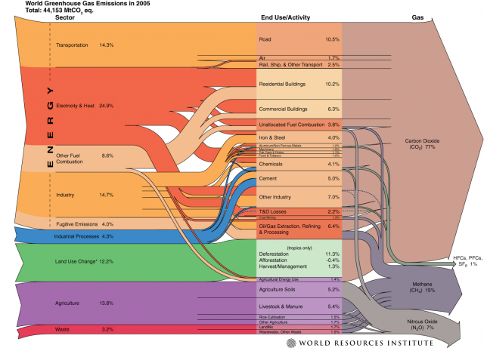
Where do GHG come from?

Slide 13
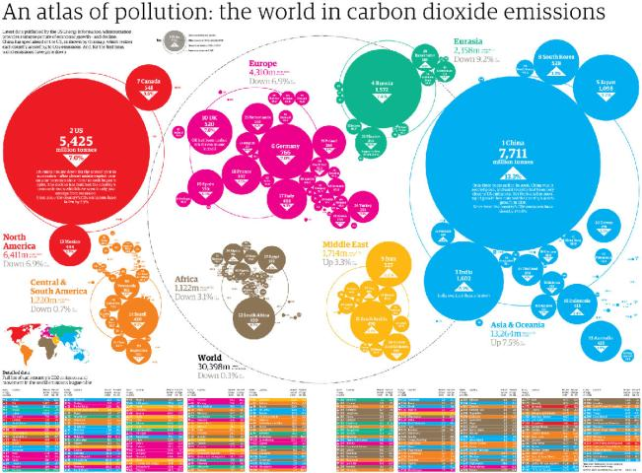
Who are the biggest emitters?

Slide 14
Trivia Q1
Question: Which country was the biggest emitter of GHG per capita in 2010?

Slide 15
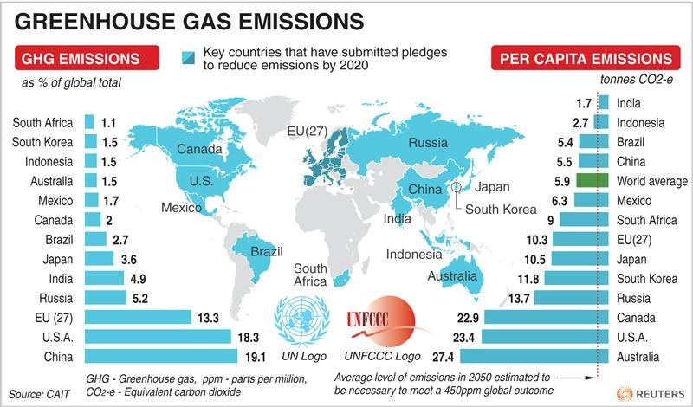
Who are the biggest emitters?

Slide 16
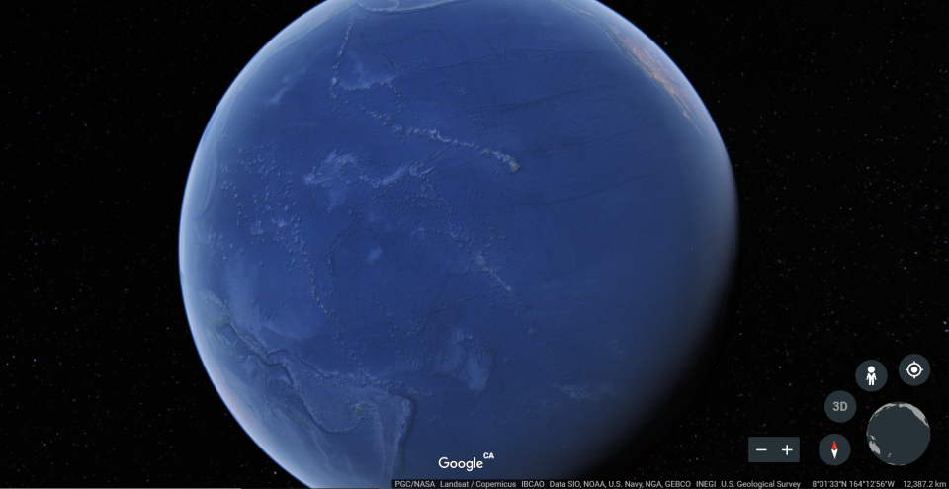
What else is changing?

Slide 17
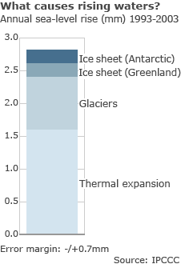
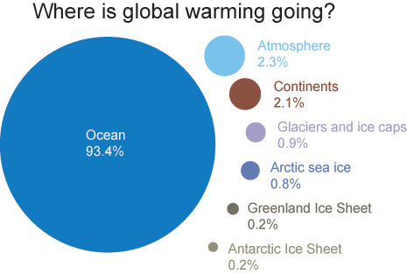
What else is changing?

Slide 18
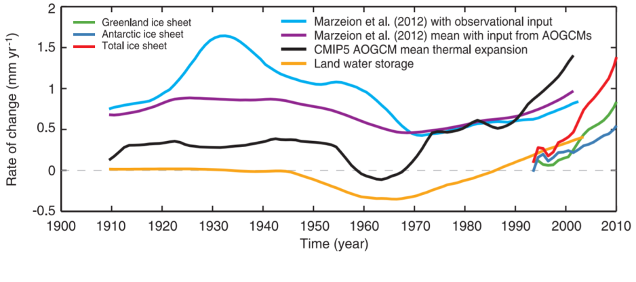
What else is changing?
Global mean sea level change
1901-1990: 1.5 mm/y
1971–2010: 2.0 mm/y
1993–2010: 3.2 mm/y

Slide 19
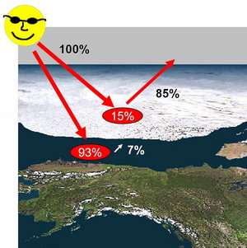
What else is changing?

Slide 20
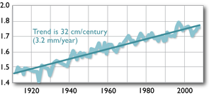
What else is changing?
Observed increase in water level at Charlottetown Harbour
metres above referenced level on land

Slide 21
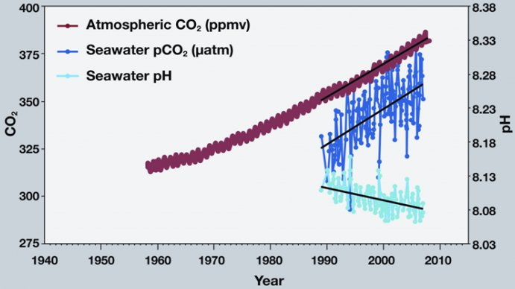
What else is changing?

Slide 22
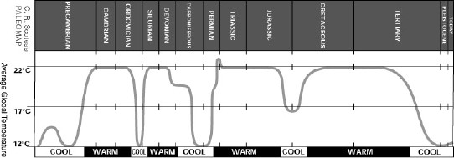
Aren’t these changes natural?
dinosaurs

Slide 23
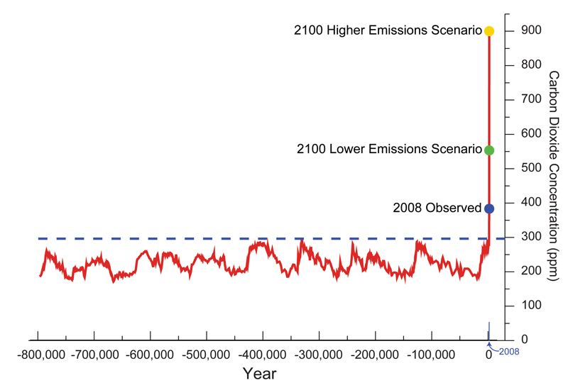
Aren’t these changes natural?

Slide 24
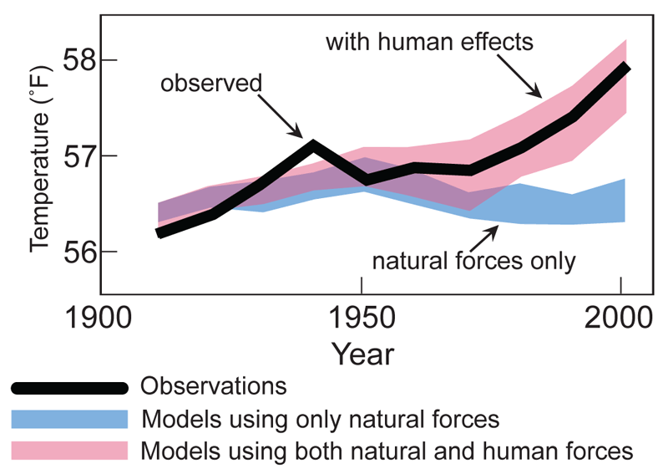
Aren’t these changes natural?

Slide 25
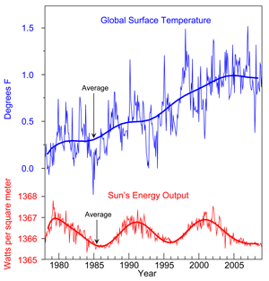
Aren’t the changes natural?

Slide 26
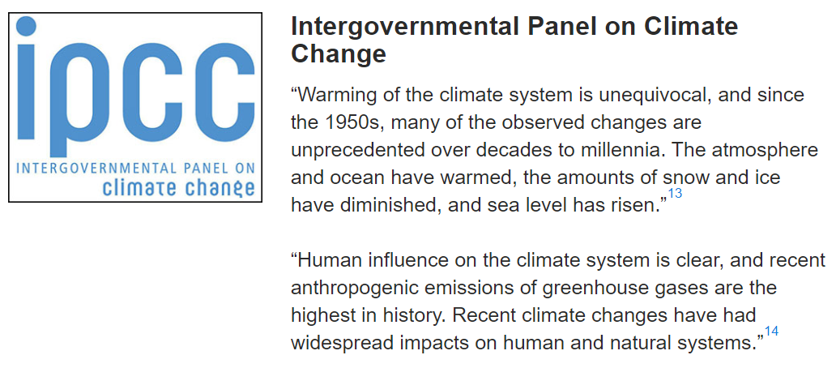
Do climate scientists agree?

Slide 27
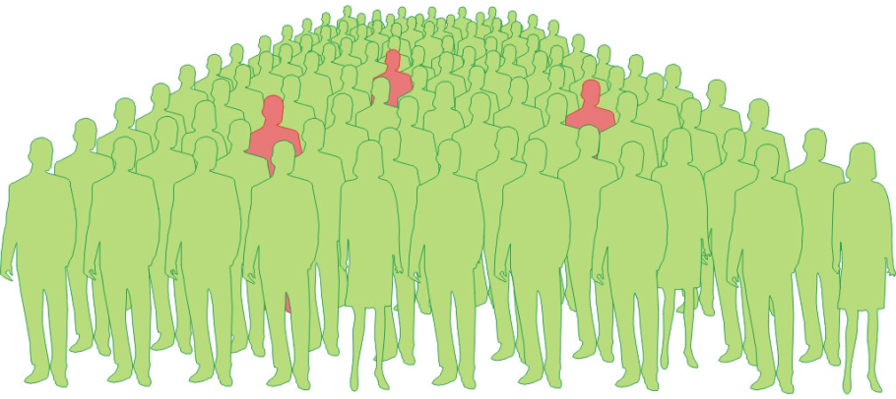
Do climate scientists agree?

Slide 28
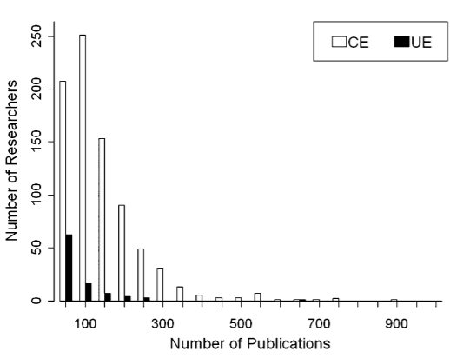
Do the climate scientists agree?

Slide 29
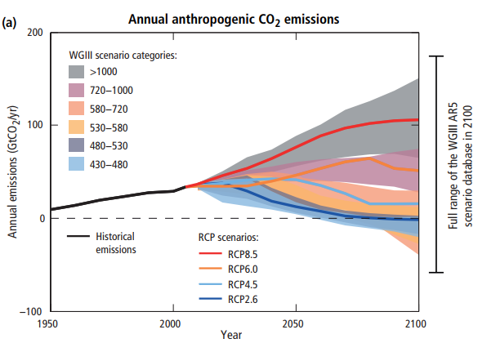
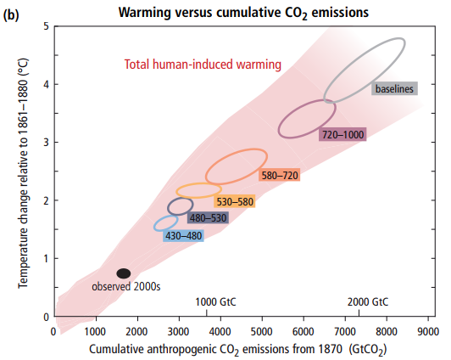
What does the future hold?

Slide 30
Trivia Q2
Question: What is the surface area of the earth in m²?
Answer: 510 trillion m²

Slide 31
What does the future hold?
(1981-2010)
(2011-2040)
(2041-2070)
(2071-2100)

Slide 32
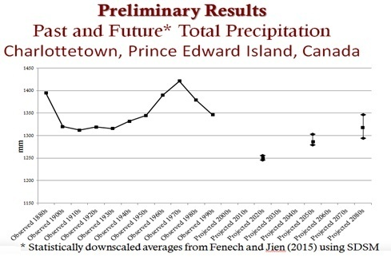
What does the future hold?

Slide 33
So what?
Opportunities
Tourism
Agriculture

Slide 34
So what?
Challenges
New pests, pathogens, diseases, invasive species (agriculture, fish, forestry, human health, water)
Shifting range of current species (agriculture, fish, forestry)
Decoupling important ecological relationships (agriculture, fish, forestry and biodiversity)
Increasing water requirements for crops

Slide 35
So what?
Challenges (con’t)
Marine life will struggle in acidic waters
Lower air quality
Change in timing and rate of aquifer recharge
More runoff (water quality, fish kills, anoxic events, infrastructure damage)
More properties and infrastructure at risk of wind damage, flooding and erosion

Slide 36
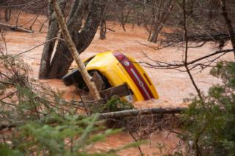
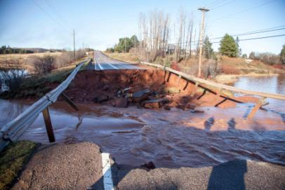
So what?

Slide 37
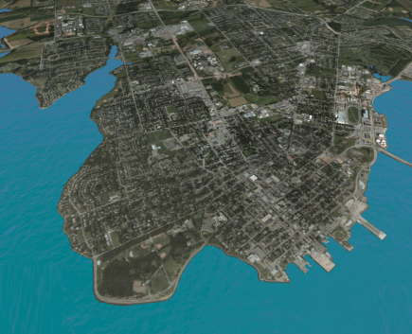
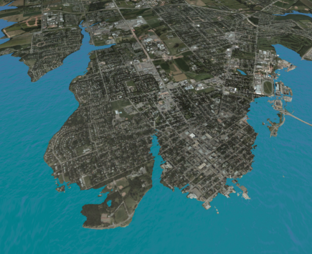
So what?
0 m
3 m

Slide 38
What can we do?
CLIMATE CHANGE
MITIGATION
=
Reducing greenhouse gas (GHG) emissions
ADAPTATION
=
Preparing for and dealing with climate change

Slide 39
Paris Agreement
Commitment to keep the rise in global temperatures below 2°C compared to pre-industrial times, while striving to limit them even more, to 1.5°C.
Canada has committed to reducing greenhouse gas emissions by 30% by 2030 compared to levels in 2005.

Slide 40
Federal carbon pricing structure
Motor fuels, home heating fuels, electricity
2018: $10/tonne GHG
…
2022: $50/tonne GHG
$10/tonne of GHG adds approximately:
$0.023/L gasoline
$0.027/L diesel
$0.015/L propane

Slide 41
NEGECP
In 2015, the group developed voluntary targets to reduce emissions by 35-45% below 1990 levels by 2030.
Prince Edward Island has signed on to this agreement and the Government is committed to playing its part

Slide 42
Trivia Q3
Question: What was PEI’s GHG emissions in 1990?
Answer: 2 million tonnes

Slide 43
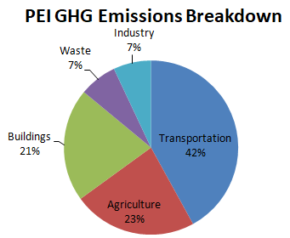
Mitigation
Buildings & facilities
Food & farming
Forestry management
Movement of people & goods
Other Strategies

Slide 44
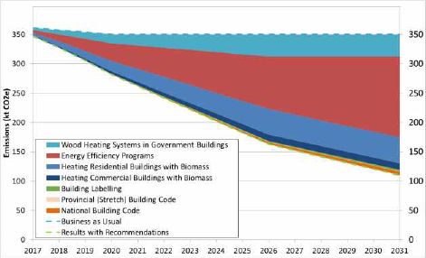
Mitigation
Buildings and Facilities
Biomass – gov’t
Energy efficiency
Biomass - residential
12%

Slide 45
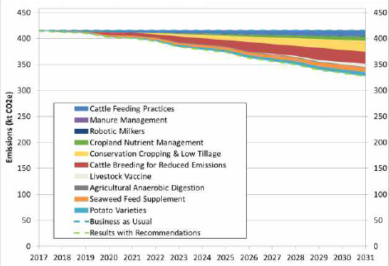
Mitigation
Food and Farming
Cattle feeding
Conservation cropping
Cattle breeding
Seaweed feed supplement
4%

Slide 46
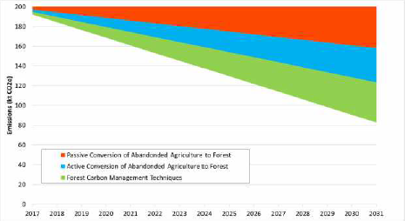
Mitigation
Forestry Management
Conversion - passive
Conversion - active
Carbon management
6%

Slide 47
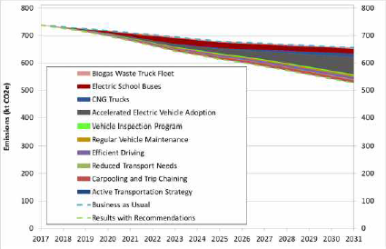
Mitigation
Moving People and Goods
Conversion - passive
Conversion - active
Electric school buses
CNG Trucks
Accelerated EV adoption
Carbon management
5%

Slide 48
Mitigation
Other Strategies
On-site composting option for rural residents
Education and outreach campaign focused on behaviour change
Local food strategy
Support municipalities

Slide 49
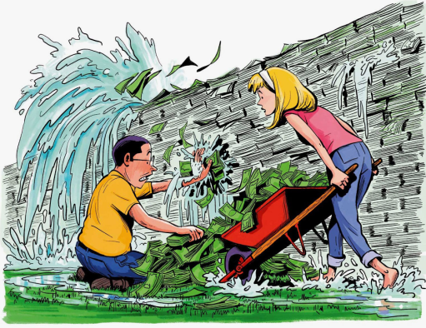
Adaptation
Fill knowledge gaps
Reduce non-climatic factors
Increase resilience
Promote climate change mainstreaming
Increase collaboration
Engage in outreach
Leverage regulation
Address financial concerns

Slide 50
Adaptation
Fill knowledge gaps
Build an understanding of water requirements and common methods to address them
Identify potential diseases and pathogens and how they can be managed
Make availability risk maps available
Develop guidelines on shore stabilization and flood mitigation techniques
Increase capacity within governments

Slide 51
Adaptation
Reduce non-climatic factors, increase resilience
Decentralize, diversify, and increase redundancy in energy infrastructure
Reduce runoff
Relocate buildings and infrastructure
Increase connectivity among natural areas
Utilize green infrastructure to manage stormwater
Actively maintain, restore, enhance and create wetlands

Slide 52
Adaptation
Promote climate change mainstreaming
Update design standards
Add flexibility to regulations
Incorporate climate change in school curriculum
Integrate climate change impacts in all management activities, policies, programs

Slide 53
Adaptation
Increase collaboration, engage in public outreach
Effective communication of risks and actions
On-site demonstrations
Incorporate Traditional Ecological Knowledge

Slide 54
Adaptation
Address financial concerns
Assign an economic value to ecosystem services provided by forests
Perform preventive adaptation
Use cost-benefit analysis to prioritize adaptation actions
Provide financial incentive/assistance to homeowners for storing stormwater onsite

Slide 55
Adaptation example: Runoff
Sectors | Impacts
Agriculture | Loss of inputs and soil
Fish and aquaculture | Poor water quality Fish kill
Insurance | Demand for coverage Risk exposure
Properties and Infrastructure | Damage from gully erosion and inland flooding
Public health and safety | Waterborne disease outbreaks Blue-green algae blooms
Water | Stress on stormwater management systems Impact on stream and aquifer recharge

Slide 56
Adaptation example: Runoff
Sectors | Recommended Adaptation Actions
Agriculture | Develop water management practices and structures (e.g., rainwater harvesting, manmade ponds, soil features)
Fish and aquaculture | Evaluate effectiveness of the current buffer zone under future climate conditions
Forestry and biodiversity | Promote the use of rain gardens and green roofs to reduce runoff and increase biodiversity
Insurance | Develop new products
Properties and Infrastructure | Use green infrastructure
Water | Design new/upgrade existing stormwater management systems to cope with future climate

Slide 57
Challenges
Creeping climate change
Bigger than self
Uncertainty
Lack of funding
Insufficient incentive
Lack of guidance
High level of coordination

Slide 58
Trivia Q4
Question: In what year was this closing statement of the World Conference on the Changing Atmosphere made?
Answer: 1988
“Humanity is conducting an unintended, uncontrolled, globally pervasive experiment, whose ultimate consequences are second only to global nuclear war.”

Slide 59
It’s a collective endeavour, it’s collective accountability and it may not be too late.
Christine Lagarde

Slide 61
Further Questions
Contact:
Stephanie Arnold
starnold@upei.ca
902-894-2852

